Slide 1

Palm Detect
By: Chipirliu Denis

Slide 2
Introduction
Project Overview : The gesture-controlled LED system is an innovative project aimed at leveraging hand gestures to control the intensity and count of LEDs using Python and Arduino. The system utilizes a webcam and the mediapipe library for hand gesture recognition, enabling users to interact with the LED system through intuitive hand movements.
Objectives : Create a responsive and interactive system that interprets hand gestures in real-time.
Control the brightness and count of LEDs based on specific hand gestures detected by the system.
Implement a seamless integration between Python and Arduino to enable gesture-based control of hardware components.
Project Vision: The project aims to demonstrate the potential of gesture recognition technology in simplifying human-machine interactions and exploring creative ways of controlling hardware systems through intuitive gestures.

Slide 3
Project Components
1. Arduino Board:
The core hardware component responsible for interfacing with LEDs and receiving control signals from Python via the pyfirmata library.
2. LEDs:
Light Emitting Diodes used as the output elements, manipulated based on the hand gestures detected by the system.
3. Webcam:
Utilized to capture live video input, facilitating the mediapipe library's hand gesture recognition functionality.

Slide 4
Project Components
4. Python:
The primary programming language used to implement the gesture recognition system, leveraging the mediapipe and OpenCV libraries for image processing.
5. Pyfirmata Library:
A Python library that allows communication between the Python environment and the Arduino board, enabling real-time control of hardware components.
6. Mediapipe Library:
A powerful library for various machine learning-based solutions, employed here for real-time hand tracking and gesture recognition.
7. Supporting Components:
This includes necessary cables, resistors, and other accessories to ensure proper connectivity and functioning of the system.

Slide 5
Working Principle
1. Hand Gesture Detection:
Utilizes the webcam and the mediapipe library for real-time hand tracking and gesture recognition.
The mediapipe library processes the video feed to identify specific hand landmarks.
2. Mapping Gestures to LED Control:
Hand gestures, detected by landmark positions, are mapped to control LED intensity and count.
Hand movement and distances between landmarks determine LED brightness and the number of LEDs to activate.
3. Python-Arduino Communication: Python interacts with the Arduino board through the pyfirmata library. Sends commands to adjust LED brightness and count based on the recognized hand gestures.

Slide 6
Working Principle
4. Real-time Responsiveness:
The system continuously tracks hand gestures, enabling real-time adjustments of LED parameters.
Immediate changes in LED behavior correspond to the detected gestures without any significant delay.
5. System Feedback:
Provides visual feedback on the LED intensity and count based on the recognized gestures.

Slide 7
Code overview
1. Python Code: Written primarily in Python, leveraging OpenCV, mediapipe, and pyfirmata libraries.Handles webcam input, mediapipe hand tracking, and gesture recognition.
Establishes communication with the Arduino board via the pyfirmata library to control LEDs.
2. Arduino Sketch:
A simple Arduino sketch is uploaded to the Arduino board to facilitate communication with Python.
Listens for commands sent by Python to adjust LED brightness and count.
3. Code Structure: Organized into functions for hand gesture detection, LED control, and Python-Arduino communication.
Utilizes loops and conditional statements to interpret gestures and control LEDs accordingly.
4. Integration of Libraries: Integration of OpenCV, mediapipe, and pyfirmata libraries for seamless interaction between hardware and software components.

Slide 8
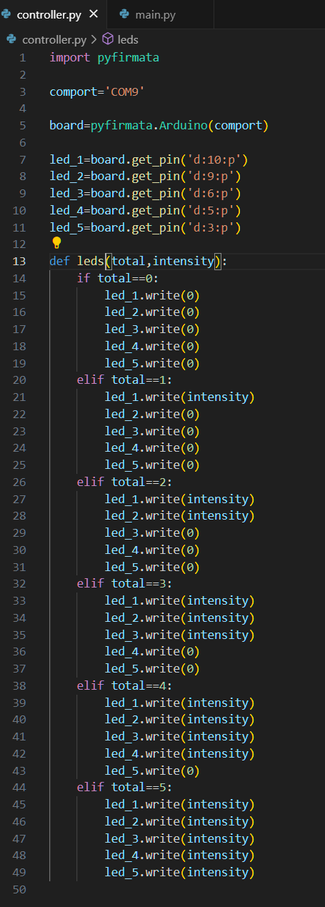
Code breakdown - Controller
1. Arduino Connection:
Initialize communication with Arduino using Pyfirmata library.
Define the COM port (e.g., 'COM9’).
2. LED Pin Configuration:
Assign PWM pins to individual LEDs (e.g., pins 10, 9, 6, 5, 3).
Utilize board.get_pin() to initialize LEDs.
3. LED Control Function:
leds(total, intensity) function:
Control LEDs based on the total count and intensity.
Utilize conditional statements for different LED configurations (0 to 5 LEDs).
Write appropriate intensity values to each LED pin.
4. LED Intensity Scaling:
Dynamically adjust LED intensity based on the 'intensity' parameter.
Ensure smooth transitions between LED states.

Slide 9
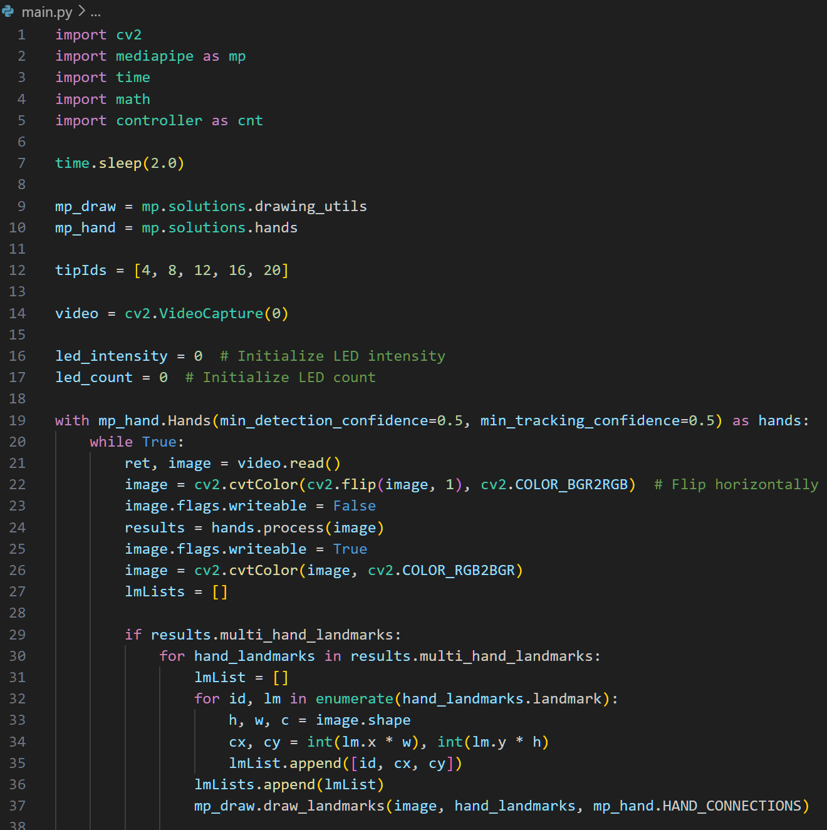
Code breakdown - Main
1. Initialization and Imports:
Import necessary libraries (cv2, mediapipe, time, math).
Import the controller module as cnt.
Introduce a 2-second sleep to ensure stable script startup.
2. Hand Tracking Setup:
Utilize Mediapipe library for hand tracking.
Initialize hand tracking components
(mp.solutions.drawing_utils and mp.solutions.hands).
3. Video Capture:
Use OpenCV (cv2.VideoCapture) to capture video
from the default camera (camera index 0).
Flip the video horizontally for a more intuitive experience.
4. LED and Hand State Initialization:
Initialize variables for LED intensity (led_intensity) and LED count (led_count).

Slide 10
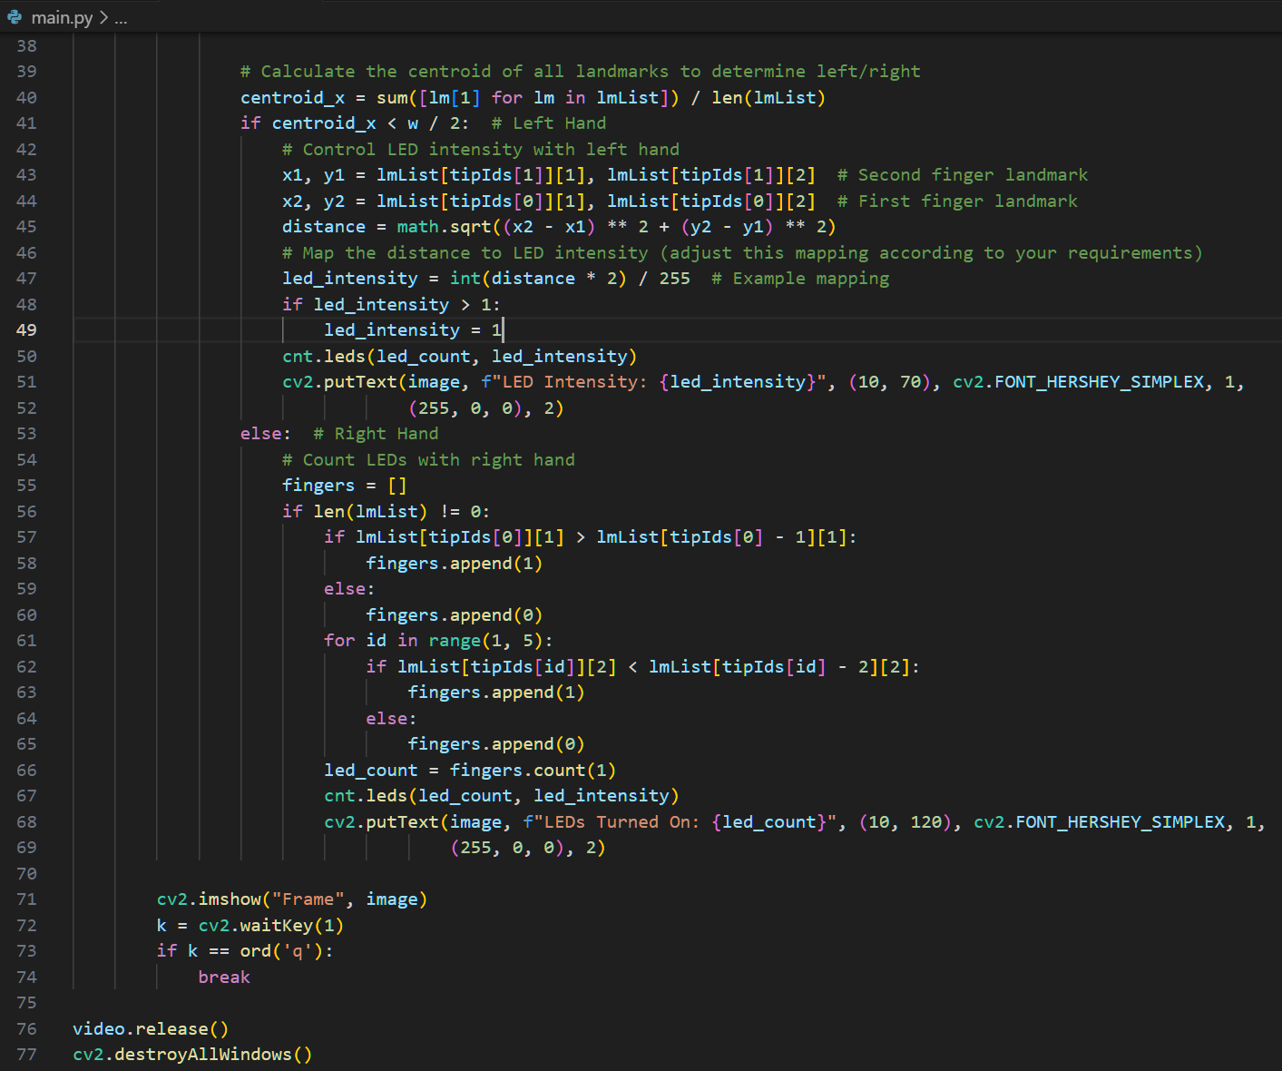
Code breakdown - Main
5. Hand Landmark Detection Loop:
Loop through frames to continuously detect hand landmarks.
Extract landmarks' coordinates and draw hand connections on the frame.
6. Left Hand (Control LED Intensity):
Calculate the centroid to determine left/right.
If the centroid is on the left, calculate the distance
between two fingers to set LED intensity.
Map the distance to LED intensity (scaled between 0 and 1).
Ensure intensity does not exceed 1.
Control LEDs using the cnt.leds() function.
7. Right Hand (Control LED Count)
If the centroid is on the right, count the number of fingers raised.
Control LEDs based on the finger count using cnt.leds().
Display LED count and intensity on the frame.

Slide 11
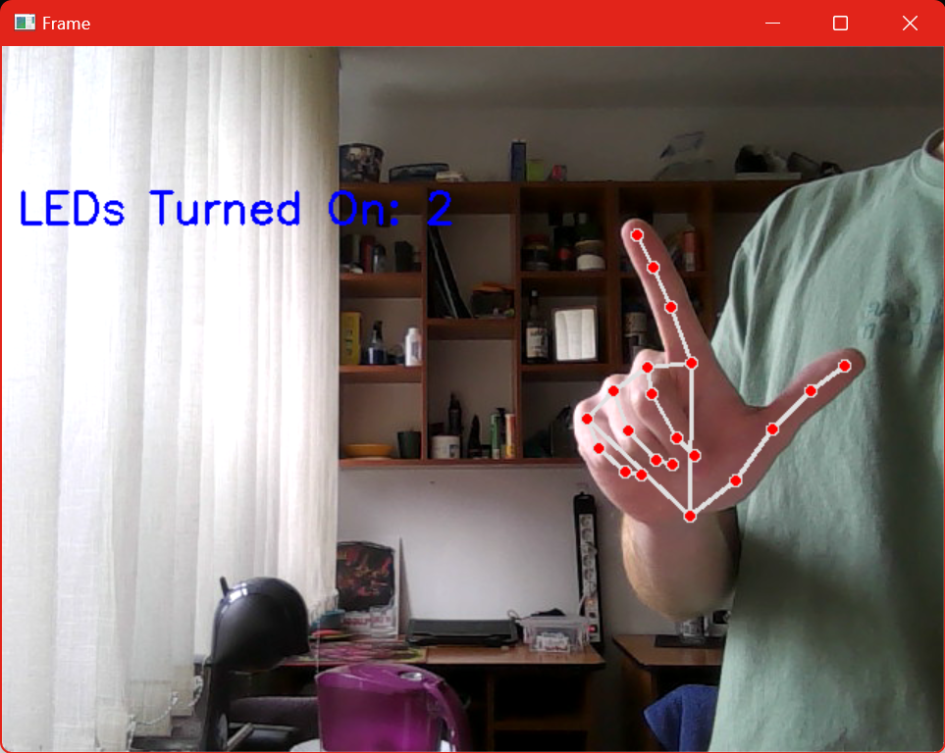
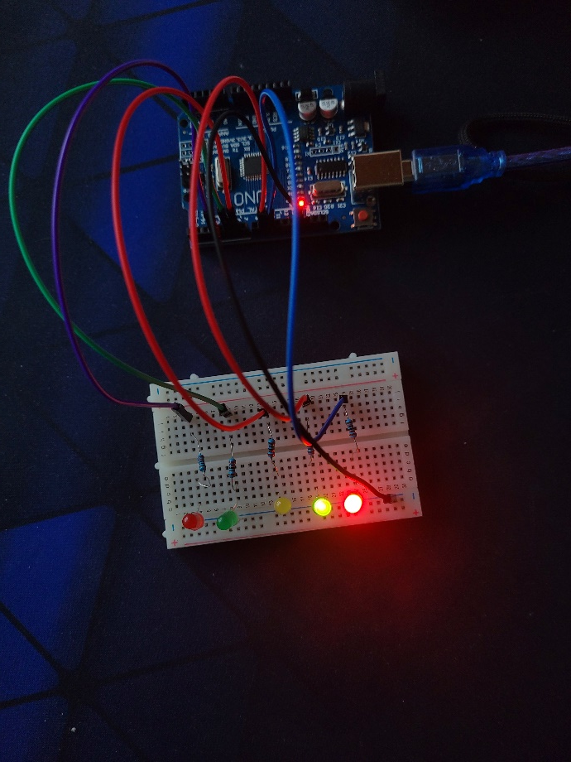
Demonstration - Leds Turned On

Slide 12
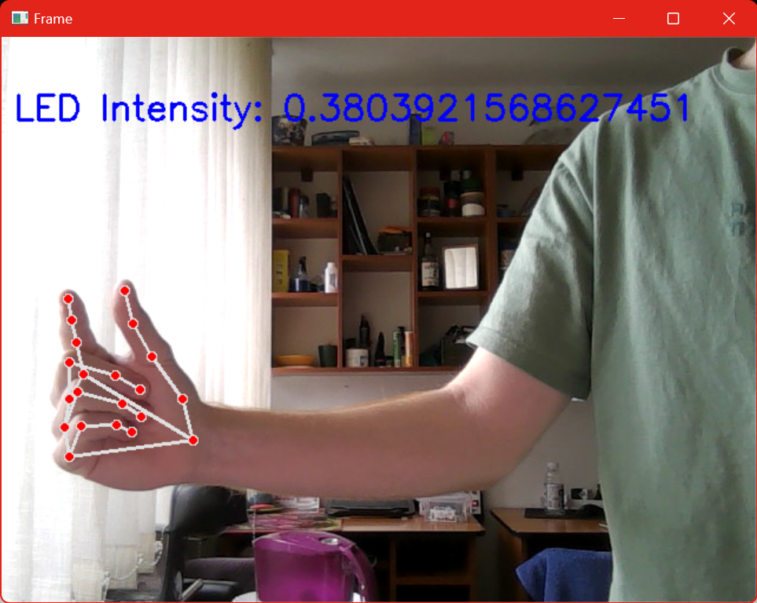
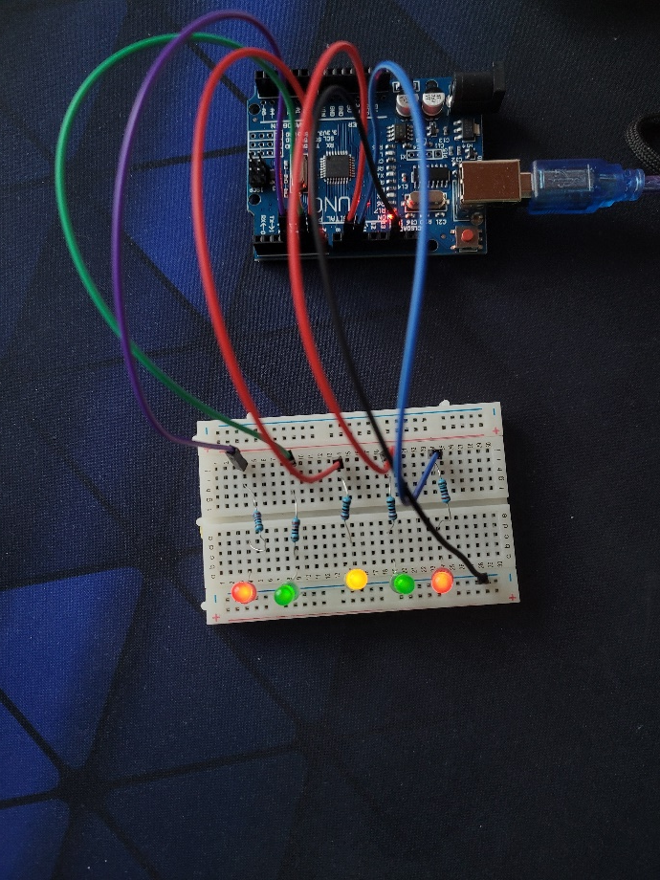
Demonstration - Led Intensity

Slide 13
Result and Functionality
1. LED Responsiveness:
Discuss the system's ability to accurately respond to different hand gestures.
Highlight the LED brightness modulation and the accurate counting of LEDs based on gesture recognition.
2. Real-Time Control:
Emphasize the system's ability to provide immediate responses to hand gestures without noticeable delay.
Highlight the seamless interaction between hand movements and LED behavior.
3. System Stability:
Discuss the stability and reliability of the system in varied conditions or user scenarios.
Mention any performance considerations or areas of improvement noticed during testing.

Slide 14

Thank You!

